Slide 1
Mimic Me walkthrough
Christopher Gusman

Slide 2
Out line of my project
Create a program that allows for the KTX humanoid to mimic my actions.

Slide 3
What does that entail?
Using the camera on the KTX
Motion detection algorithm
How to interpret that moti0n
Using the motors on the KTX to mimic that motion that he has interpreted

Slide 4
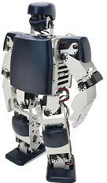
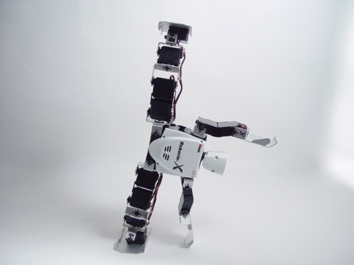
Plan of attack
Compare
Image 1
Image 2
Step 1: Observe
Step 2: Motion Detection
Desktop Application
Send
Image Output
Step 3: Send output to desktop
Step 4: Mimic and save the movement observed

Slide 5
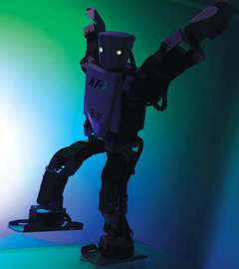
Playback!
Step 5: Show everyone what he’s learned

Slide 6
What have I done so far?
Prototyping the motion detection algorithm
Started with a nice package product that I had to set aside
Current approach is simple camera program in c#

Slide 7
Program model
Take picture
First?
Yes
Save a copy and grayscale for comparison
No
Create a copy grayscale & compare to first
No processing need yet just send original image for display
Color changed pixels with big enough change
Try to calculate lines to trace movement
Display processed image

Slide 8
Current to do
Understand pixel movements - Blob processing
Raise events based on blob interpretation
Bring in the robot and start testing

Slide 9
Suggestions?

Slide 10
Immediate plan
Get these events rolling and get past this hiccup with some sort of assistance. Seems I need fresh eyes to see what I am not seeing.

Slide 11
References
Stick man
http://www.google.com/imgres?q=stick+person&um=1&hl=en&sa=N&rlz=1C1CHFX_enUS448US448&biw=1440&bih=743&tbm=isch&tbnid=_EQGVVcoRDfoDM:&imgrefurl=http://www.angryblacklady.com/2010/10/01/i-need-a-good-recipe-for-sticky-rice/&docid=033SBm45rTHDcM&imgurl=http://www.angryblacklady.com/wp-content/uploads/2010/10/sticky-person.jpg&w=266&h=320&ei=lAVUT972MYXhgge3sPWqCw&zoom=1&iact=rc&dur=299&sig=103597008310691314042&page=2&tbnh=143&tbnw=119&start=23&ndsp=30&ved=1t:429,r:5,s:23&tx=44&ty=100
KTX Humanoid
Step 1 - My webiste – sited there
Step 3 - http://www.google.com/imgres?q=ktx+humanoid+robot&um=1&hl=en&sa=N&rlz=1C1CHFX_enUS448US448&biw=1440&bih=799&tbm=isch&tbnid=IEuhaY08QwxOEM:&imgrefurl=http://www.electronickits.com/robot/KT-X.htm&docid=c678LbX51jPtSM&imgurl=http://www.electronickits.com/robot/KT-XKick.jpg&w=709&h=531&ei=_glUT578EdPdggfT4-X2CQ&zoom=1&iact=hc&vpx=985&vpy=452&dur=423&hovh=194&hovw=259&tx=126&ty=88&sig=103597008310691314042&page=2&tbnh=139&tbnw=181&start=30&ndsp=35&ved=1t:429,r:33,s:30
Step 5 - http://www.google.com/imgres?q=ktx+humanoid+robot&um=1&hl=en&sa=N&rlz=1C1CHFX_enUS448US448&biw=1440&bih=799&tbm=isch&tbnid=xUXMZMGMIdToeM:&imgrefurl=http://find.botmag.com/511166&docid=Zc9xiITnLdm8eM&imgurl=http://find.botmag.com/sites/upload_files/botmag/files/kumotek_10.jpg&w=240&h=270&ei=_glUT578EdPdggfT4-X2CQ&zoom=1&iact=hc&vpx=907&vpy=197&dur=534&hovh=212&hovw=188&tx=60&ty=124&sig=103597008310691314042&page=2&tbnh=141&tbnw=125&start=30&ndsp=35&ved=1t:429,r:25,s:30

